Slide 1
Plum Customer Success Insights
By
Shanmukha Priya K

Slide 2
An Introductory Overview
Plum is an employee insurance and health benefits platform focused on making health insurance simple, accessible and inclusive for modern organizations.
Plum's Customer Success Team is tasked with handling a diverse range of customer queries and issues efficiently to maintain a high standard of customer experience.
The provided dataset reveals varying levels of performance across different groups within the team in terms of resolution time, first reply time, and the number of interactions required to resolve tickets.

Slide 3
Objective
The primary objective is to analyze and optimize the performance of Plum's Customer Success Team across various dimensions – including group performance, ticket prioritization, and communication channel effectiveness – to enhance overall efficiency, reduce resolution times, and improve customer satisfaction.

Slide 4
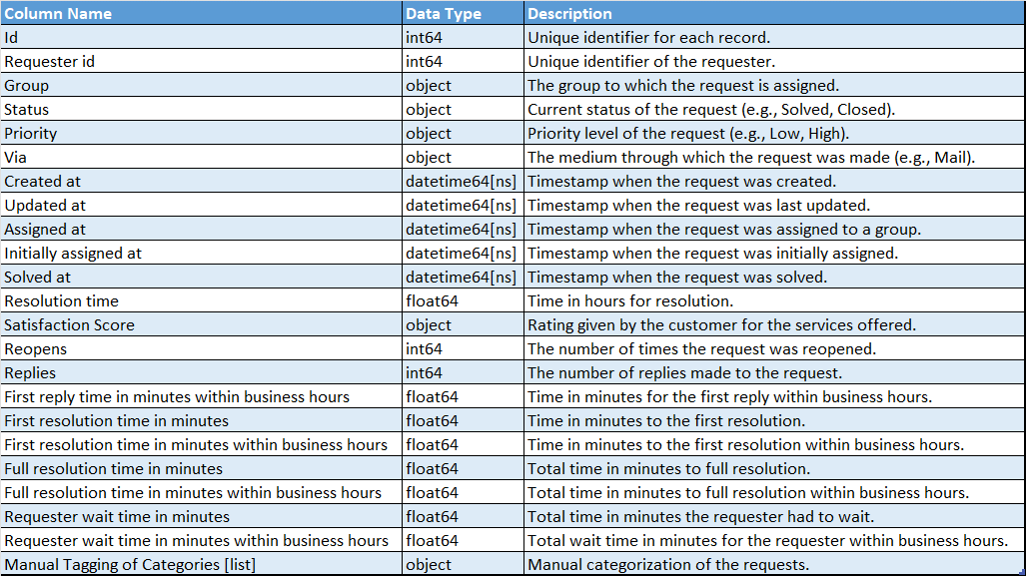
Data Expedition

Slide 5
Tidying the Dataset: A Clean Slate Approach
Using Excel

Slide 6
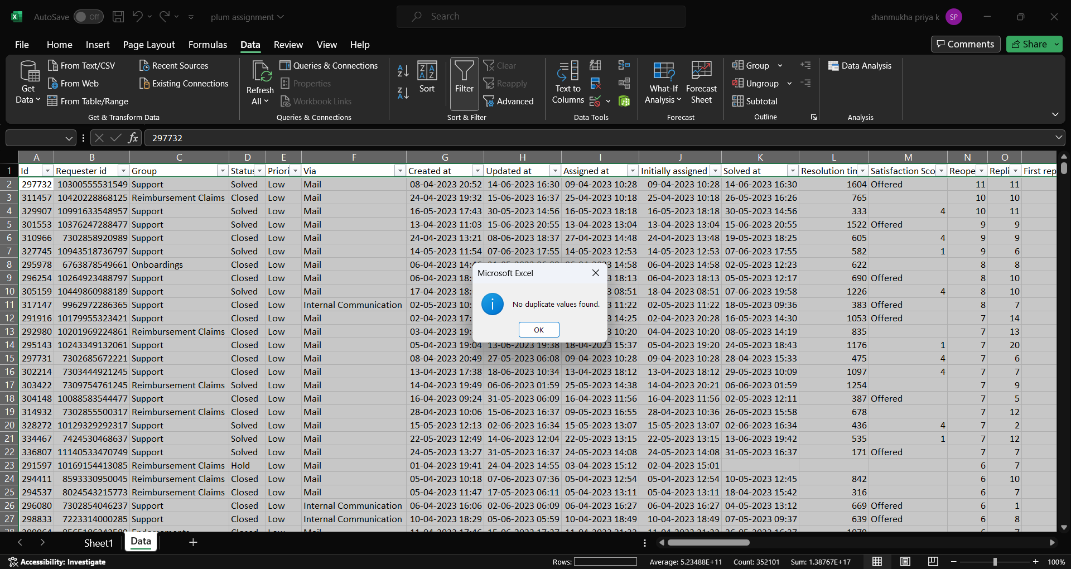
Duplicates Check

Slide 7
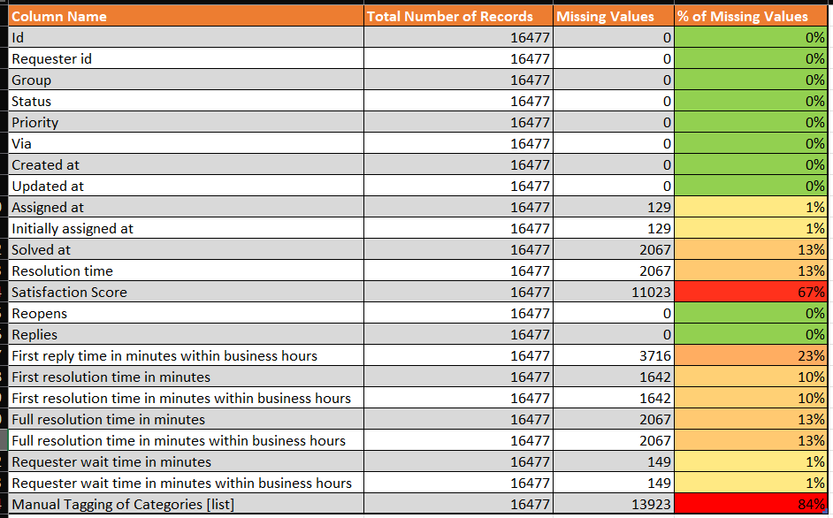
Data Summary at glance
Take Away: Satisfaction Score & Category columns have more than 30% of null values. These are significant in analysis so replacing the null values that are appropriate

Slide 8
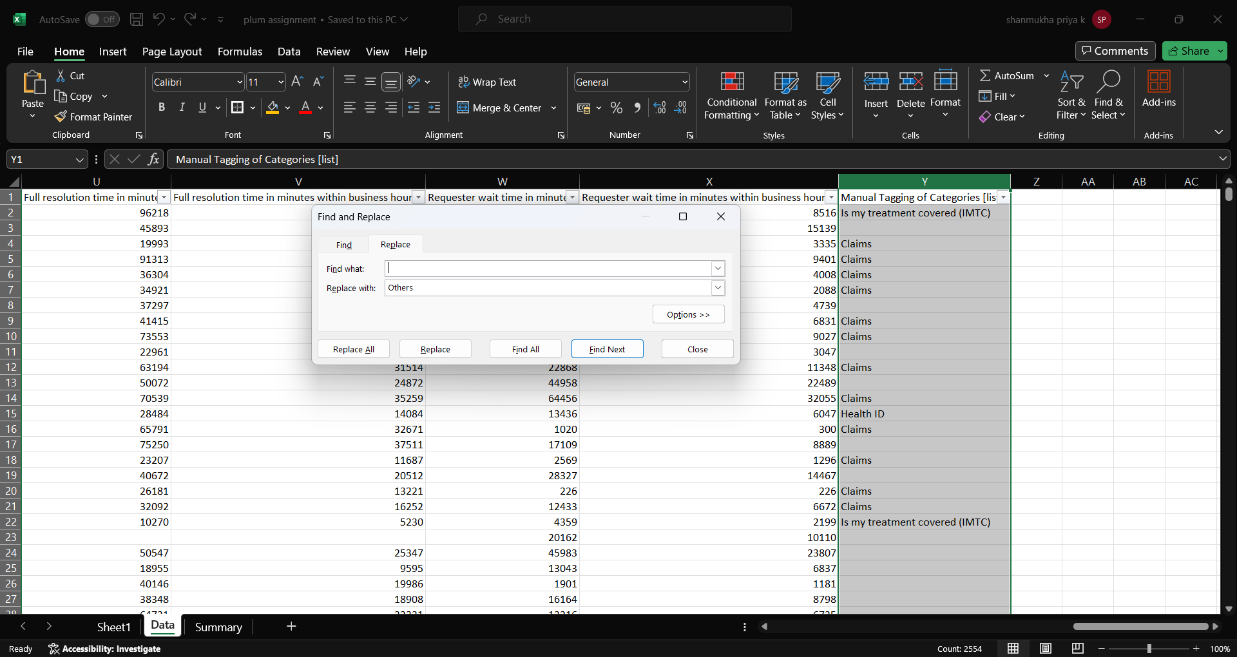
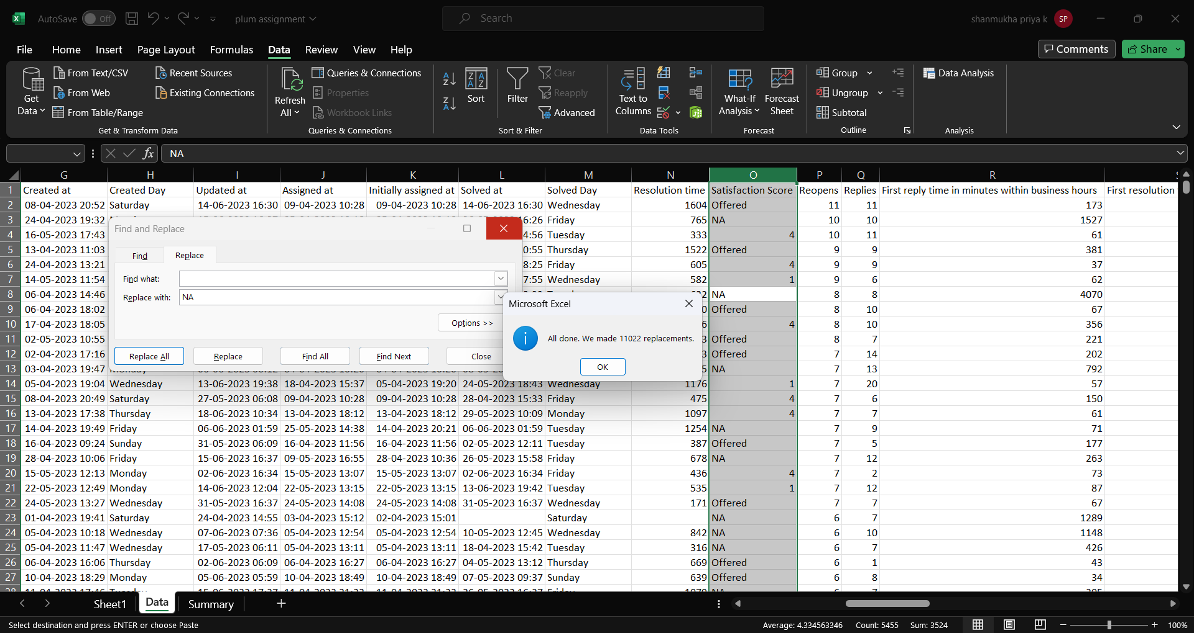
Treating Major Null Values
Classified empty records as Others
No Score given records treated as NA

Slide 9
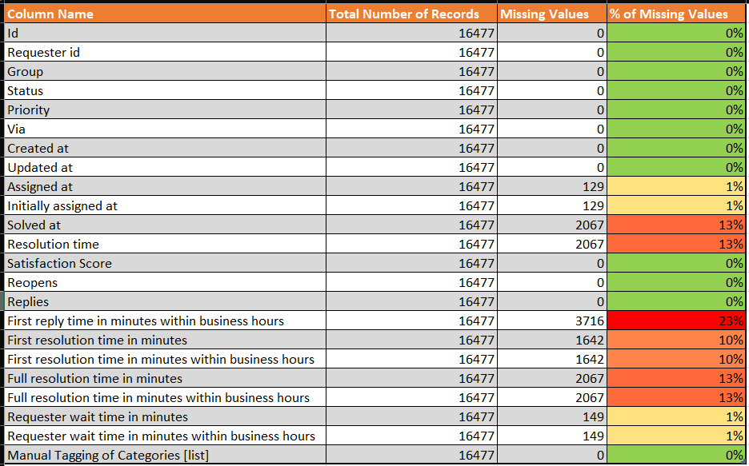
Summary after treating Primary Null Values

Slide 10
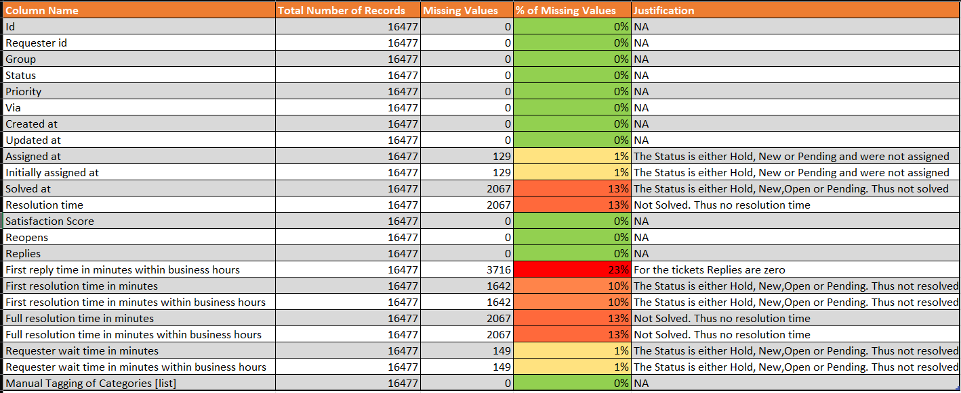
Reasons Summarised for the Null Values
Take Away: The ticket Status for majority of null value records is either Open, New, Hold or Pending. For other tickets there were no Replies given.

Slide 11
Exploratory Endeavours: Unveiling Insights
Using SQL & Power BI

Slide 12
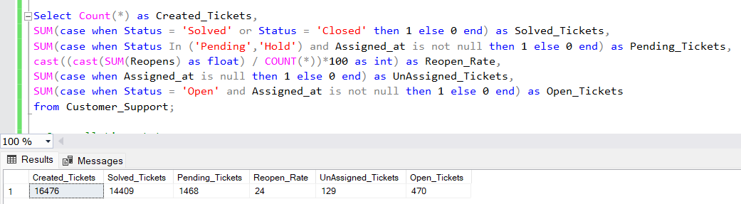
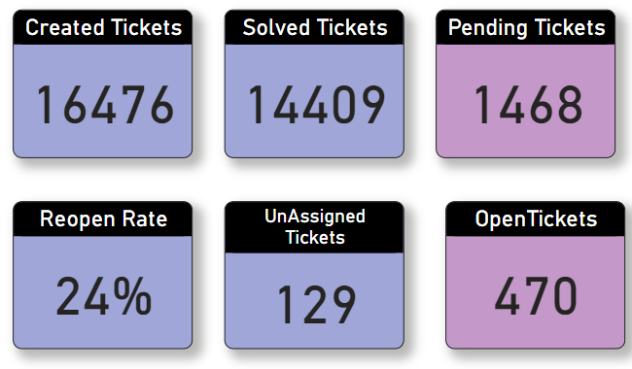
Overview of Tickets Status

Slide 13
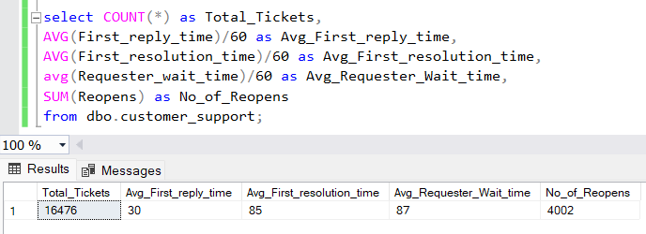
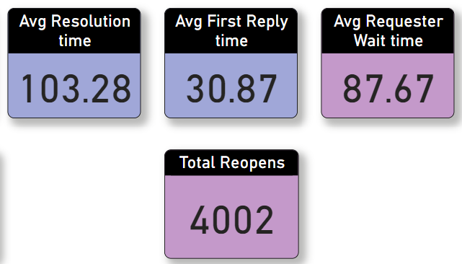
Overview of Time Measures

Slide 14
Group Performance Analysis

Slide 15
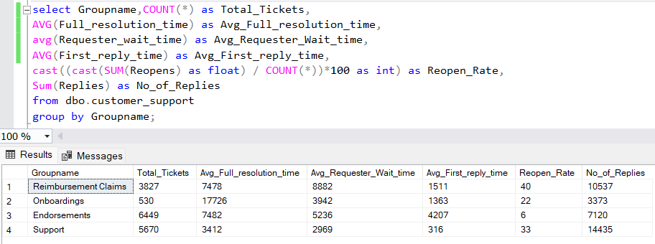
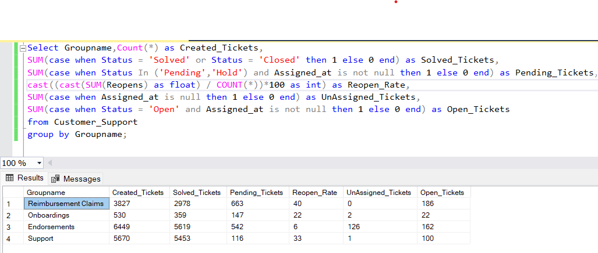
High Volume, High Resolution: 'Endorsements' leads in ticket volume and resolution, but also has a notable number of pending and open tickets. Efficient Resolution in Support: 'Support' shows a high resolution rate with comparatively fewer pending tickets. Reimbursement Claims' Pending Issue: Despite a large number of created tickets, 'Reimbursement Claims' has a significant backlog of pending tickets. Low Reopen Rate, High Efficiency: 'Endorsements' and 'Support' maintain low reopen rates, indicating effective initial resolutions. Minimal Unassigned Tickets: Across all groups, unassigned tickets are minimal, showing good initial ticket assignment practices.
Group Performance by Time
Group Performance by Ticket Count

Slide 16
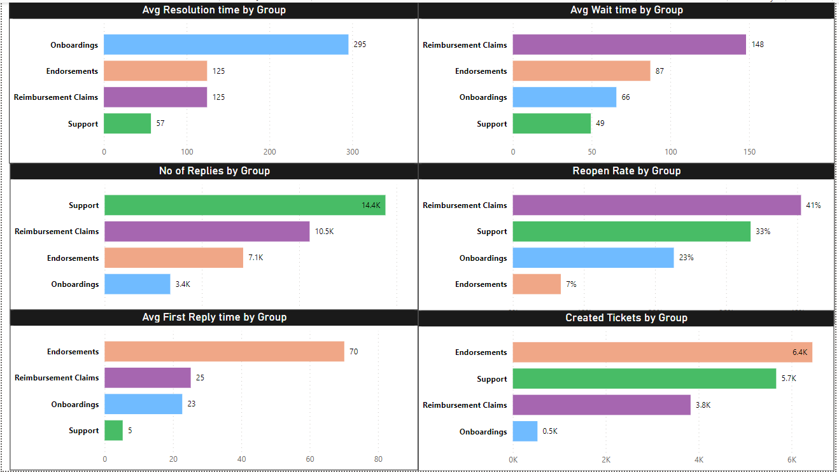
Prompt Initial Response: 'Support' excels in quick initial responses, as evidenced by the shortest average first reply time, demonstrating a commitment to prompt customer engagement. Onboarding Challenges: 'Onboardings' faces challenges with the longest average resolution and requester wait times, suggesting complexity in processes or a need for efficiency improvements. Reimbursement Process Improvement Needed: 'Reimbursement Claims' has a notably high reopen rate, indicating potential issues in achieving satisfactory resolutions on the first attempt, necessitating process review and improvements. Interaction Efficiency: Despite its efficiency in other areas, 'Support' exhibits a high number of replies per ticket, suggesting a need for more effective problem-solving in fewer interactions to enhance overall resolution efficiency.
Endorsements manages the highest ticket volume effectively with low reopen rates, indicating strong initial problem resolution despite longer first reply times.

Slide 17
Category Impact Analysis

Slide 18
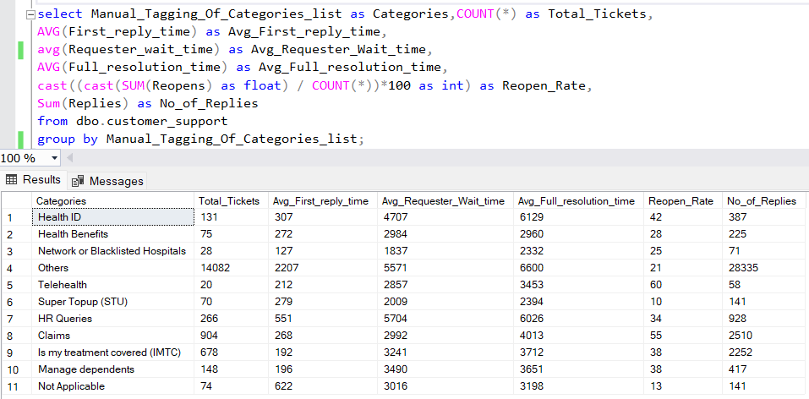
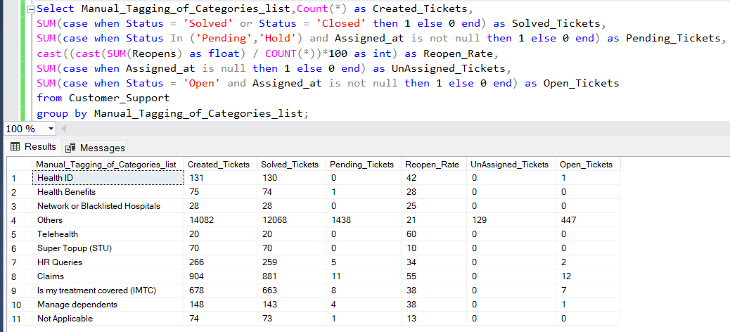
High Volume, High Closure: 'Others' has the most tickets with many still pending, indicating a heavy and ongoing workload. Effective Resolution: 'Network or Blacklisted Hospitals' and 'Super Topup (STU)' show 100% resolution, reflecting high efficiency. High Reopen Rate: 'Telehealth' has a high reopen rate, suggesting complex issues despite low ticket volume. Steady Resolution: 'Claims' and 'IMTC' balance a moderate ticket load with successful closures and few pending. Minimal Backlog: Categories like 'HR Queries' and 'Health Benefits' have almost no pending tickets, indicating swift resolutions.
Category Analysis by Time
Category Analysis by Ticket Count

Slide 19
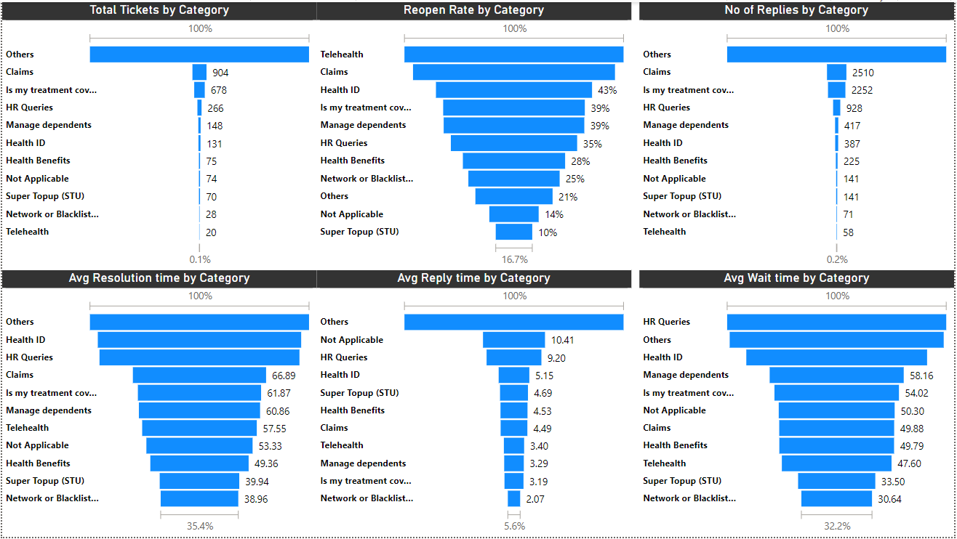
Complex Queries: 'Health ID' and 'Is my treatment covered' have high reopen and wait times, indicating complexity. HR Delays: 'HR Queries' lead in average wait time, suggesting room for process improvement. Claims Efficiency: High volume of 'Claims' tickets handled with relative efficiency, low reopen and wait times. Telehealth Challenges: Despite fewer tickets, 'Telehealth' struggles with a high reopen rate. Quick Resolutions: 'Super Topup (STU)' and 'Network or Blacklist' categories resolve quickly, suggesting simpler issues or efficient processes.
The 'Others' category has the highest total tickets and number of replies,longer resolution times.

Slide 20
Monthly Trend Analysis

Slide 21
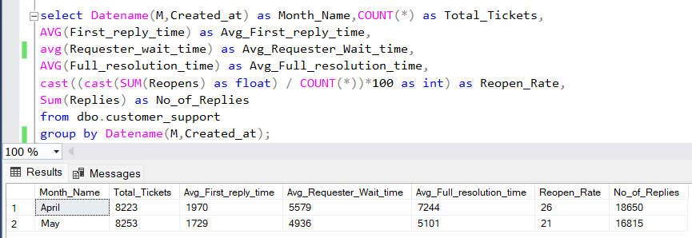
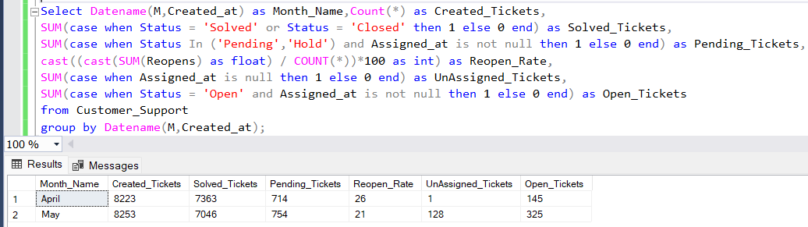
April vs. May Performance: May saw a slight increase in created tickets but a decrease in solved tickets compared to April. Pending Workload: Both months ended with pending tickets, with May having a higher number, indicating a growing backlog. Resolution Rate: The resolution rate dropped in May, as evidenced by the lower number of solved tickets despite more created tickets. Unassigned Challenges: A notable rise in unassigned tickets in May could point to resource allocation issues. Open Ticket Increase: The number of open tickets more than doubled from April to May, suggesting an accumulation of unresolved issues.
Monthly Trend Analysis by Time
Monthly Trend Analysis by Ticket Count

Slide 22
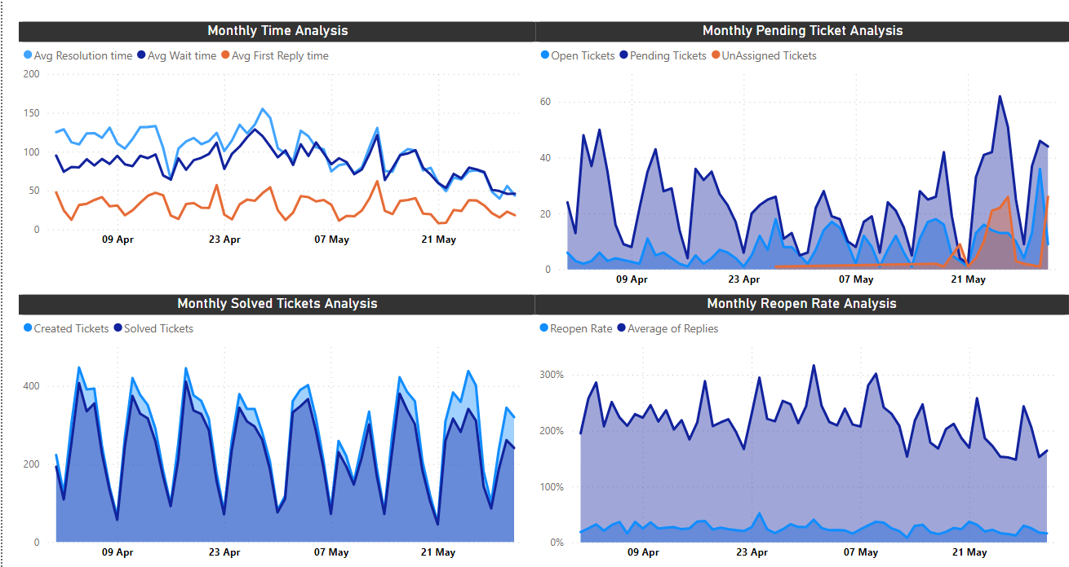
Resolution Efficiency: Average resolution time trends downward, indicating improving efficiency over time. Initial Contact: Average first reply time remains relatively steady, suggesting consistent initial engagement. Wait Time Fluctuations: Average wait time shows variability, with occasional spikes indicating inconsistent wait periods. Ticket Backlog: A significant spike in pending tickets in late May suggests a possible backlog or system issue. Reopen Dynamics: The reopen rate fluctuates, with peaks indicating periods of decreased resolution effectiveness.
Ticket resolution is improving, but variability in wait times and periodic spikes in reopens and pending tickets

Slide 23
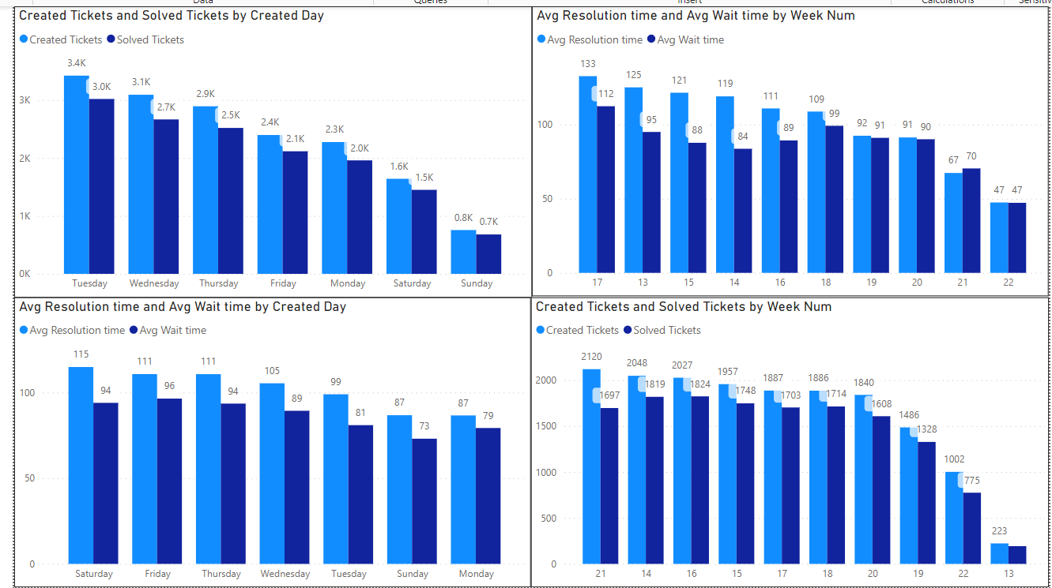
Ticket Volume by Day: The highest number of tickets are created midweek, with a decline towards the weekend. Resolution and Wait Time by Day: Average resolution and wait times are longest at the start of the week and improve by the weekend. Week-to-Week Ticket Trends: The number of created tickets fluctuates weekly, with a general downward trend over the latest weeks. Resolution Efficiency Over Time: Average resolution and wait times show variability but tend to decrease in later weeks. Weekend Efficiency: Despite fewer tickets created on weekends, the average resolution time doesn’t notably decrease, suggesting consistent processing times throughout the week.

Slide 24
Priority Based Analysis

Slide 25
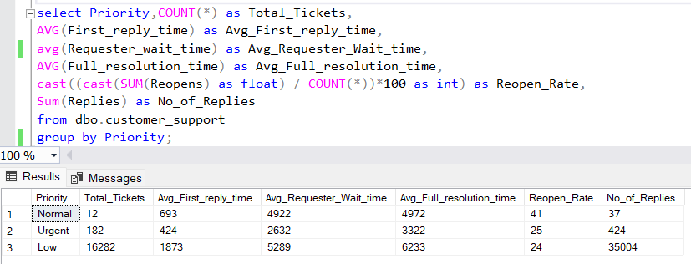
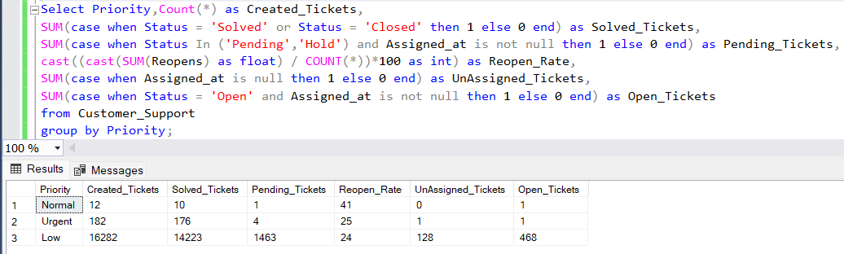
Urgent Ticket Efficiency: Urgent tickets have a high resolution rate with very few remaining open. Low Priority Backlog: Low priority tickets have a significant backlog, indicated by the high number of pending and open tickets. Reopen Rates: Normal priority tickets have the highest reopen rate, suggesting issues with initial resolutions. Unassigned Ticket Control: Almost all tickets are assigned, with unassigned tickets being a minimal concern. Volume vs. Resolution: Despite the vast majority of tickets being low priority, their resolution rate lags behind urgent tickets.
Priority Based Analysis by Time
Priority Based Analysis by Ticket Count

Slide 26
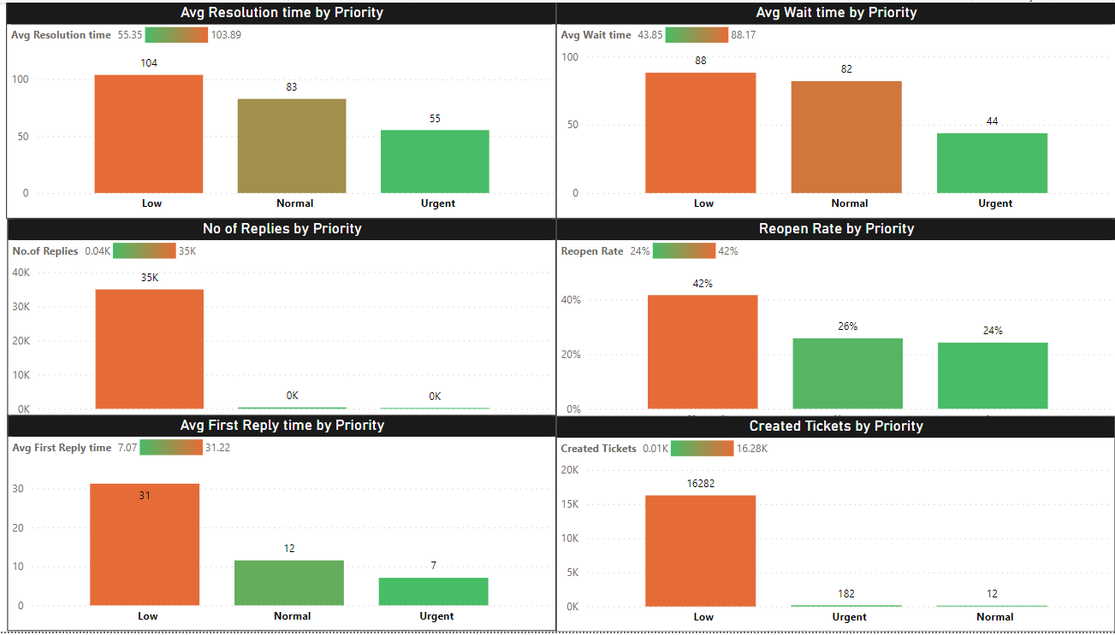
Priority Resolution Times: Urgent tickets are resolved faster than normal and low-priority tickets. Waiting Period: Low-priority tickets experience the longest wait times, while urgent ones have the shortest. Reply Efficiency: Urgent tickets receive the quickest first replies, whereas low-priority ones wait longer. Reopen Rates: Low-priority tickets have the highest reopen rate, suggesting quality issues in initial resolution. Ticket Volume: Most tickets are created with low priority, but even with high volumes, they have longer resolution times.
Urgent tickets are prioritized effectively with quicker resolutions and replies, but low-priority tickets, despite being most numerous, suffer from longer waits and higher reopen rates.

Slide 27
Communication Channel Analysis

Slide 28
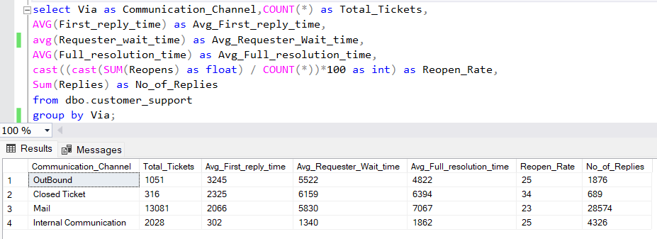
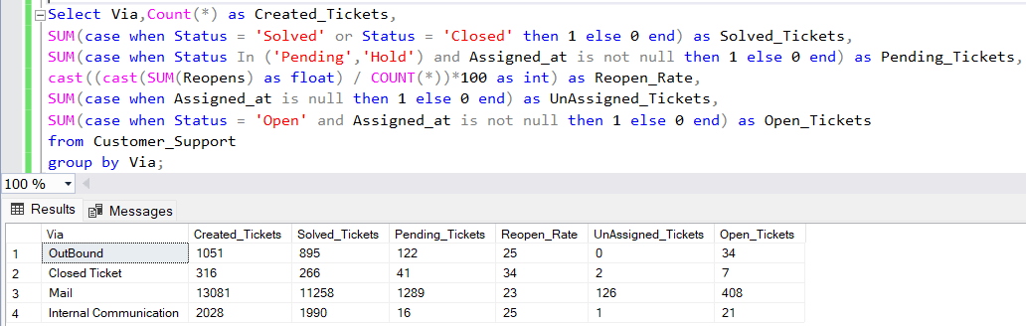
Mail Channel Load: Mail has the highest number of created and solved tickets, dominating the support channel usage. Pending Ticket Pile-Up: Mail also leads in pending tickets, indicating a backlog that could affect customer satisfaction. Reopen Rate Indicator: Closed Ticket has the highest reopen rate, suggesting a need to improve the resolution process for these tickets. Effective Internal Support: Internal Communication sees very few pending and open tickets, showcasing efficient resolution within this channel. Low Unassigned Tickets: Across all channels, the number of unassigned tickets is minimal, indicating effective initial ticket assignment.
Communication Channel Analysis by Time
Communication Channel Analysis by Ticket Count

Slide 29
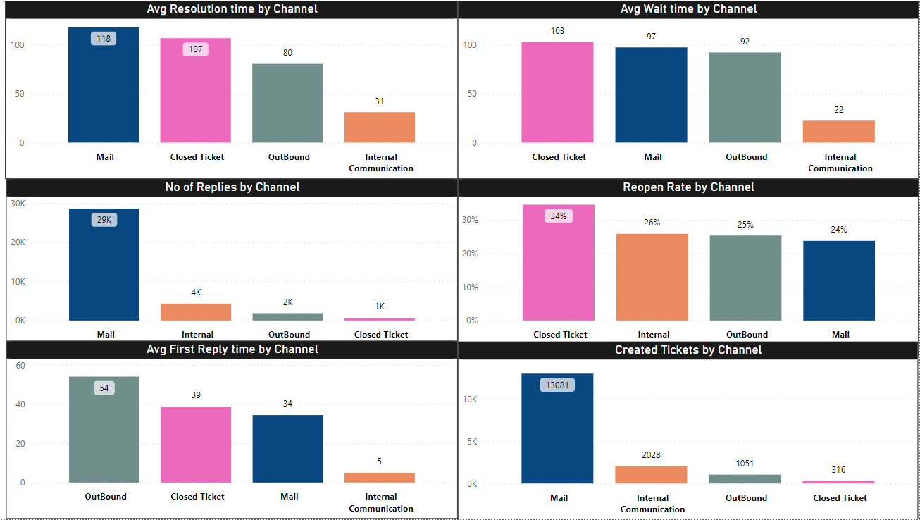
Channel Efficiency: Mail has the highest resolution time, indicating it may be less efficient than other channels. Wait Time Concerns: Closed Ticket and Mail channels have the highest average wait times, suggesting slower processing. Reopen Likelihood: Closed Ticket channel has the highest reopen rate, pointing to possible issues with initial resolution. Volume of Interactions: Mail leads in the number of replies, which could imply either more complex issues or less effective communication. Response Promptness: Internal Communication has the quickest average first reply time, indicating faster initial engagement.
Mail is the primary communication channel but is marked by longer resolution times and a significant number of replies

Slide 30
Satisfaction Score Analysis

Slide 31
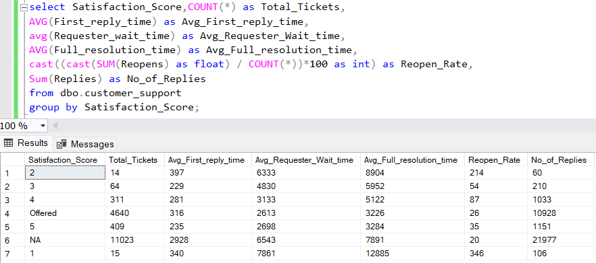
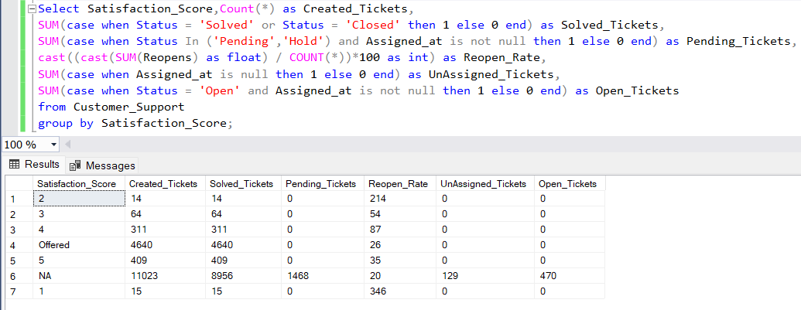
High Reopen Rates: The highest satisfaction score (5) and the lowest (1) both show higher than average reopen rates, indicating potential issues with resolving tickets to satisfaction. Satisfaction and Resolution: Tickets with a satisfaction score offered show a low reopen rate, suggesting effective resolution. Unassigned Ticket Control: Across all satisfaction scores, there are very few unassigned tickets, indicating efficient initial assignment. Pending Ticket Challenges: A significant number of tickets without a satisfaction score remain pending, highlighting a potential area for process improvement. Effective Closure: For tickets with satisfaction scores from 2 to 5 and those with an offer made, there are zero pending tickets, indicating successful resolution.
Satisfaction Score Analysis by Time
Satisfaction Score Analysis by Ticket Count

Slide 32
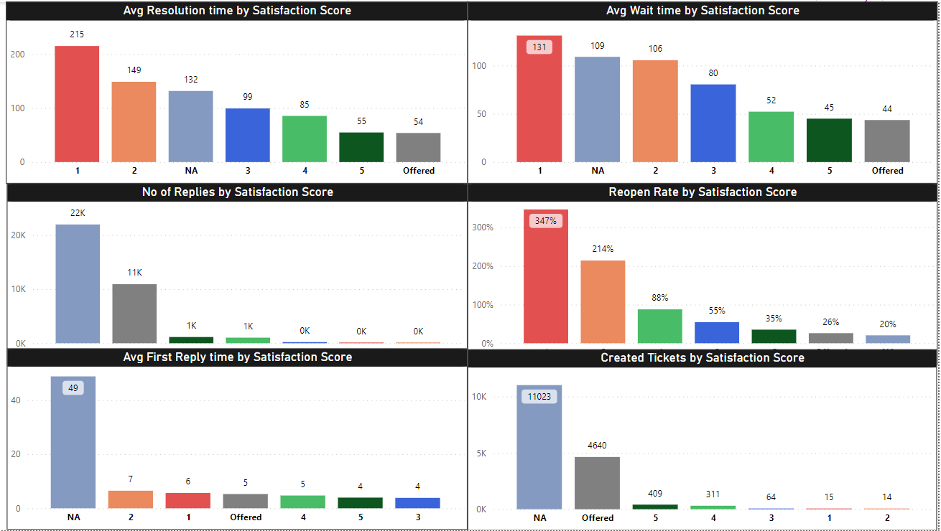
Satisfaction vs. Resolution: The highest average resolution time correlates with the lowest satisfaction score. Waiting Time Impact: Customers with the lowest satisfaction score experience the longest wait times. First Response Critical: The average first reply time is highest for customers without a satisfaction score, suggesting delays in engagement. Reopen Rate Concerns: Dissatisfied customers (score of 1) have an exceptionally high ticket reopen rate. Volume vs. Satisfaction: The majority of tickets are created by customers without a recorded satisfaction score, indicating a gap in feedback collection.
Lower customer satisfaction scores are associated with longer resolution and wait times, as well as higher reopen rates

Slide 33
Ticket Status Analysis

Slide 34
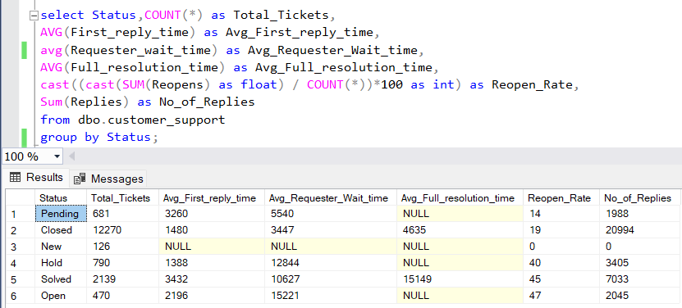
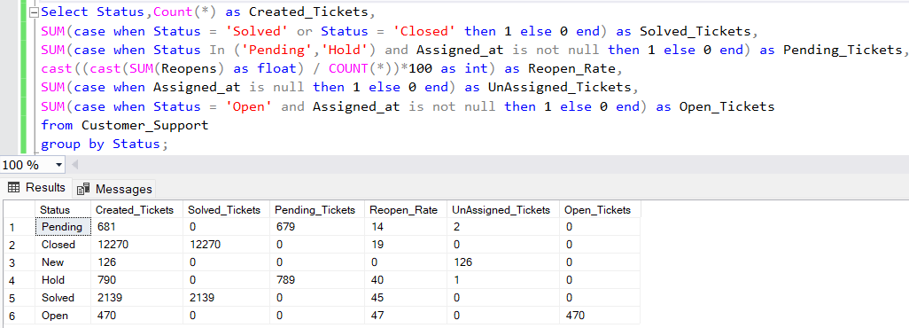
Closed Ticket Efficiency: All tickets marked as 'Closed' have been solved, indicating strong closure efficiency. Pending Ticket Volume: A large number of 'Pending' tickets exist, with almost all remaining unsolved. New Ticket Status: 'New' tickets are entirely unassigned, highlighting a potential delay at the start of the ticket lifecycle. Hold Category Attention: Tickets on 'Hold' have a high reopen rate, suggesting these may be complex cases requiring additional attention. Solved Tickets Reopen Rate: 'Solved' tickets exhibit a moderate reopen rate, indicating room for improvement in first-contact resolution.
Ticket Status Analysis by Time
Ticket Status Analysis by Ticket Count

Slide 35
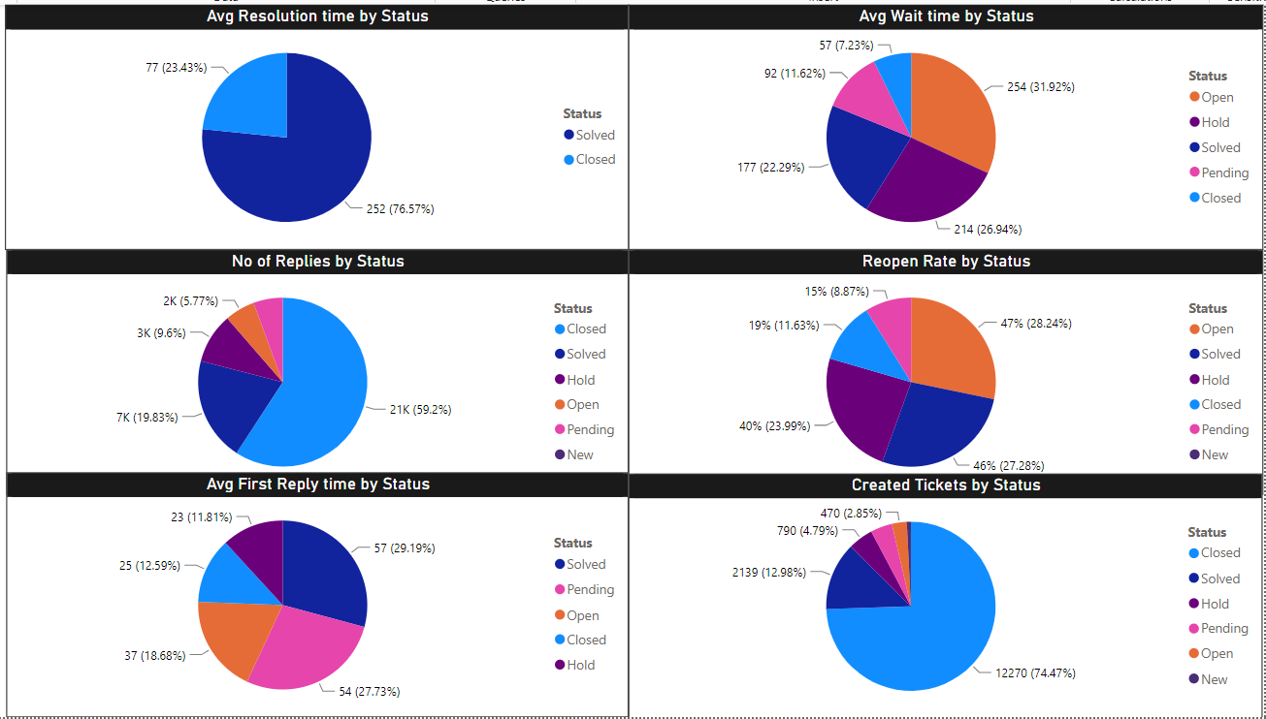
Resolution Dominance: Solved tickets constitute the largest portion of the average resolution time, indicating successful closure of issues. Waiting Time Distribution: Open and pending tickets account for the highest average wait times, suggesting delays in processing or complexity. Communication Frequency: Most replies are made to tickets with a status of 'Solved,' which may reflect ongoing dialogues to reach resolution. Urgency in First Response: New and open tickets receive the fastest first replies, showing prioritization of new issues. Reopen Rate Focus: Closed tickets have a lower reopen rate compared to new and open statuses, indicating more finality in resolution.
The ticket lifecycle management is most active with 'Solved' status tickets

Slide 36
Customer Success Performance Dashboard

Slide 37
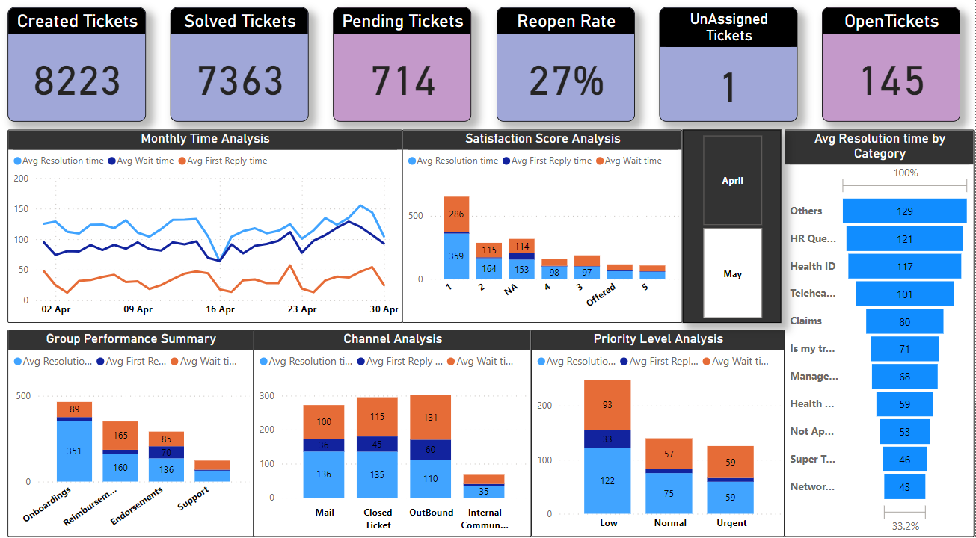
Backlog Presence: Solved tickets trail behind created ones, signaling unresolved ticket accumulation. Satisfaction Link: Lower satisfaction ties to extended resolution times. Endorsements Delay: Initial response by 'Endorsements' is quick, but resolution lags. Mail Slowdown: Mail channel struggles with the longest wait and resolution times. Urgency Mismatch: Urgent tickets endure unexpectedly high resolution times.
Summary for the month of April

Slide 38
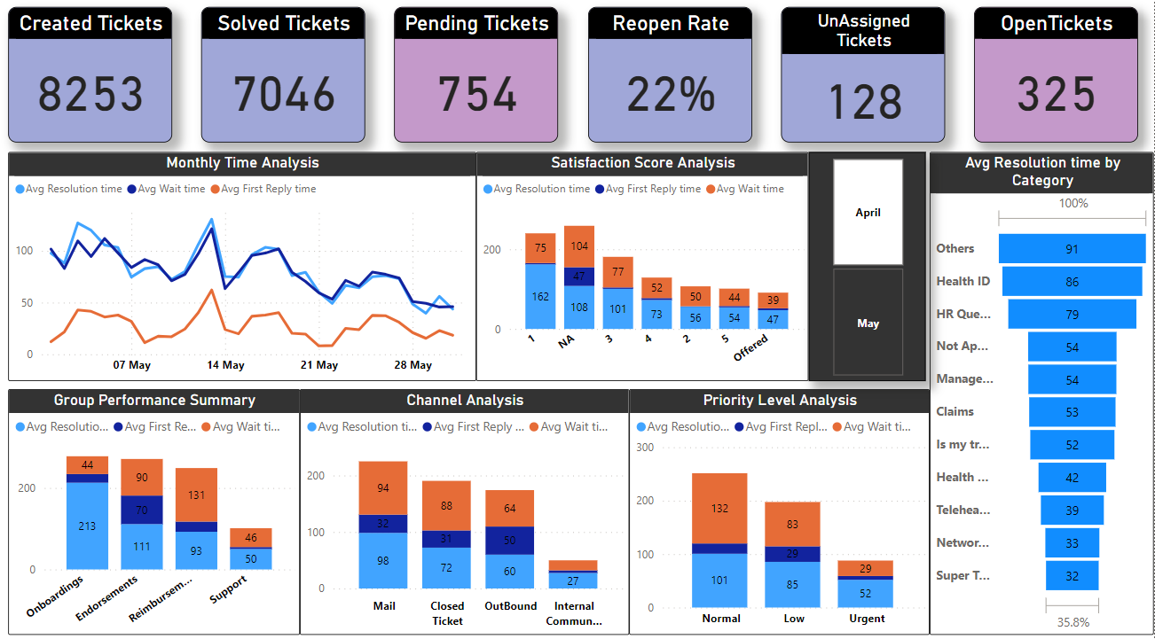
Backlog Issue: There's a persistent backlog as solved tickets lag behind new ones. Satisfaction Impact: Lower satisfaction correlates with longer resolution times. Group Discrepancies: 'Endorsements' face delays beyond initial replies. Mail Channel Slowdown: Mail is the slowest channel for resolution. Urgent Ticket Delay: Urgent tickets are not resolved as quickly as expected.
Summary for the month of May

Slide 39
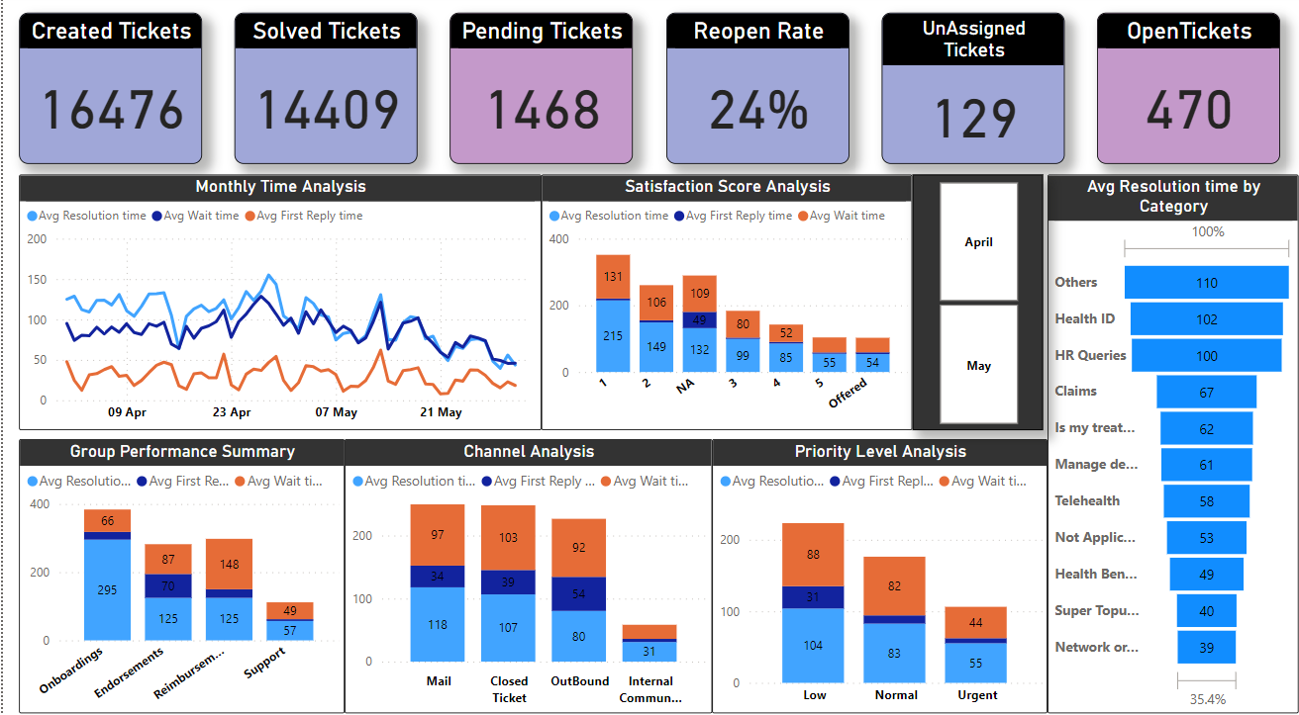
Overall Summary View

Slide 40
Key Insights and Actionable Recommendations: Unveiling the Path Forward

Slide 41
Key Insights
Ticket Volume vs. Resolution:
There is a significant number of created tickets, with a slightly lower number of tickets solved, indicating a good resolution rate but also highlighting a potential backlog as seen with pending tickets.
Reopen Rate:
A 24% reopen rate suggests that nearly a quarter of all resolved tickets had to be revisited, indicating an area for improvement in initial problem solving.
Satisfaction Score Correlation:
Lower satisfaction scores correlate with longer resolution and wait times, emphasizing the need to improve service for dissatisfied customers.
Group Performance Variation:
Different groups exhibit varying average resolution times and wait times, with 'Support' showing relatively better performance.
Priority and Response Time:
Urgent tickets have the shortest average resolution time, but they also have a higher wait time compared to low priority tickets, indicating a prioritization in the resolution but not necessarily in initial response.

Slide 42
Actionable Recommendations
Review Resolution Processes:
To address the pending ticket backlog and the high reopen rate, review and refine the resolution processes, possibly incorporating more thorough initial diagnostics or customer communication.
Focus on Low Satisfaction Scores:
Investigate the root causes of low satisfaction scores and target service improvements in those areas, such as training customer service staff or implementing more customer-centric policies.
Balance Group Workloads:
Analyze group workloads and allocate resources to balance efficiency across all groups, possibly shifting resources to where they are needed most.
Enhance Initial Response:
For urgent tickets, improve the initial response time to match the urgency of resolution, ensuring that urgent issues are both acknowledged and resolved quickly.
Category-Specific Strategies:
Develop targeted strategies for categories with longer resolution times, such as 'Health ID' and 'HR Queries', to improve efficiency in these areas.

Slide 43
Thank You

